Slide 1

Activity 3: Image Types and Formats
LEO, Kenneth M.
2015-13015
Applied Physics 186

Slide 2
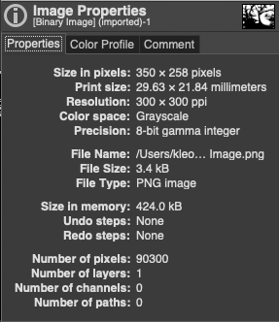
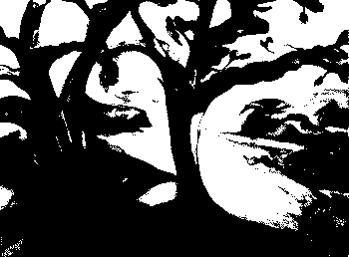
4 Basic Types of Digitized Image Binary Image
Image taken from stackoverflow

Slide 3
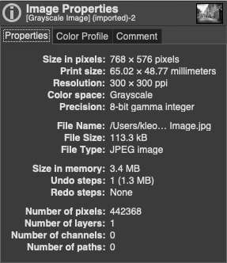
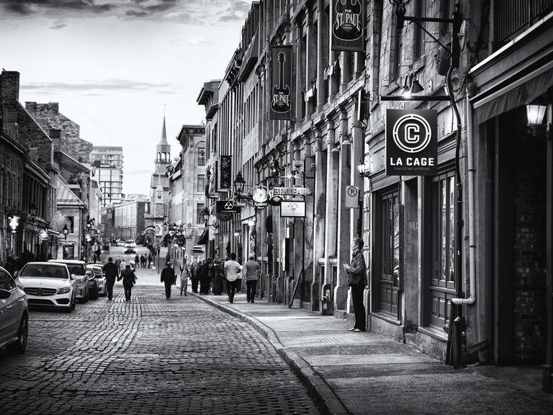
4 Basic Types of Digitized Image Grayscale Image
Image taken from google search

Slide 4
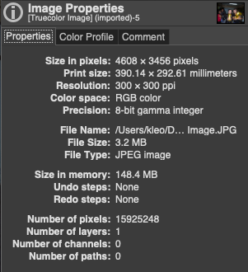
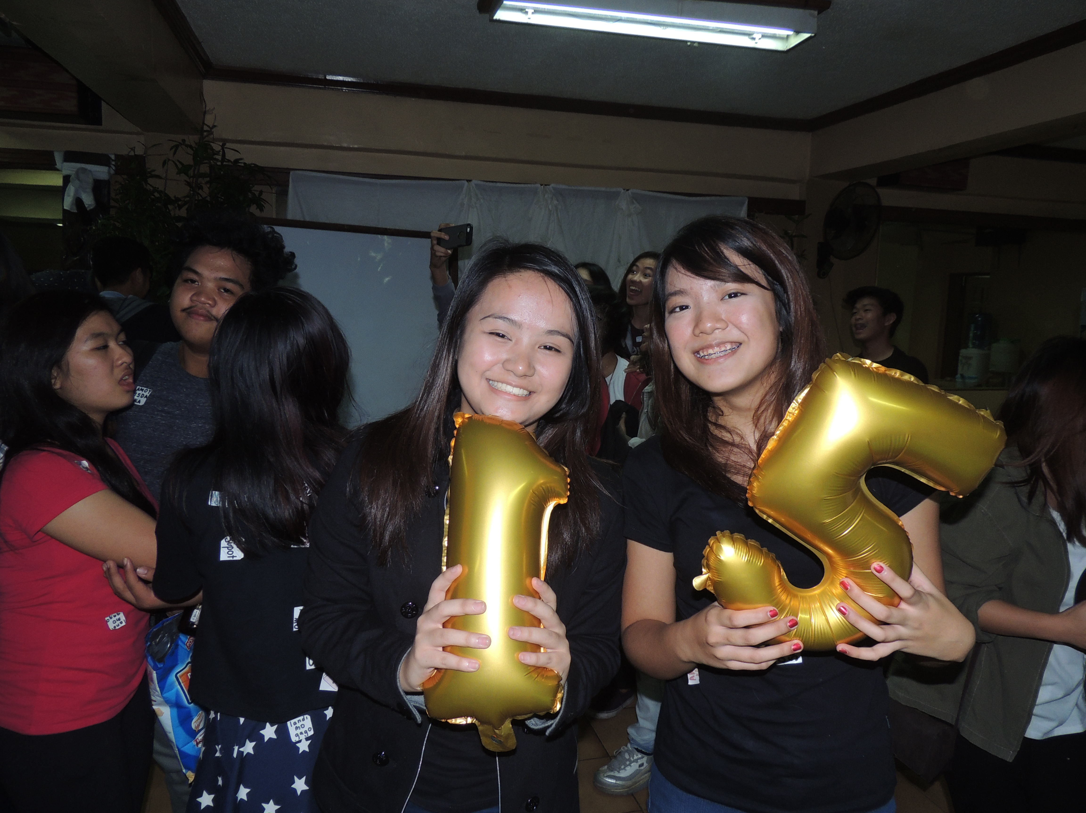
4 Basic Types of Digitized Image Truecolor Image
Image taken by me

Slide 5
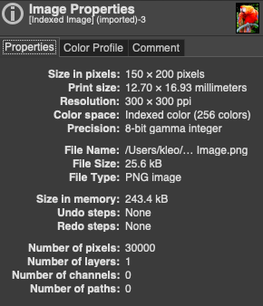
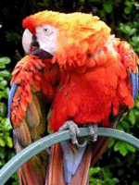
4 Basic Types of Digitized Image Indexed Image
Image taken from Wikipedia

Slide 6
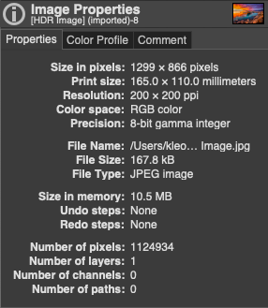
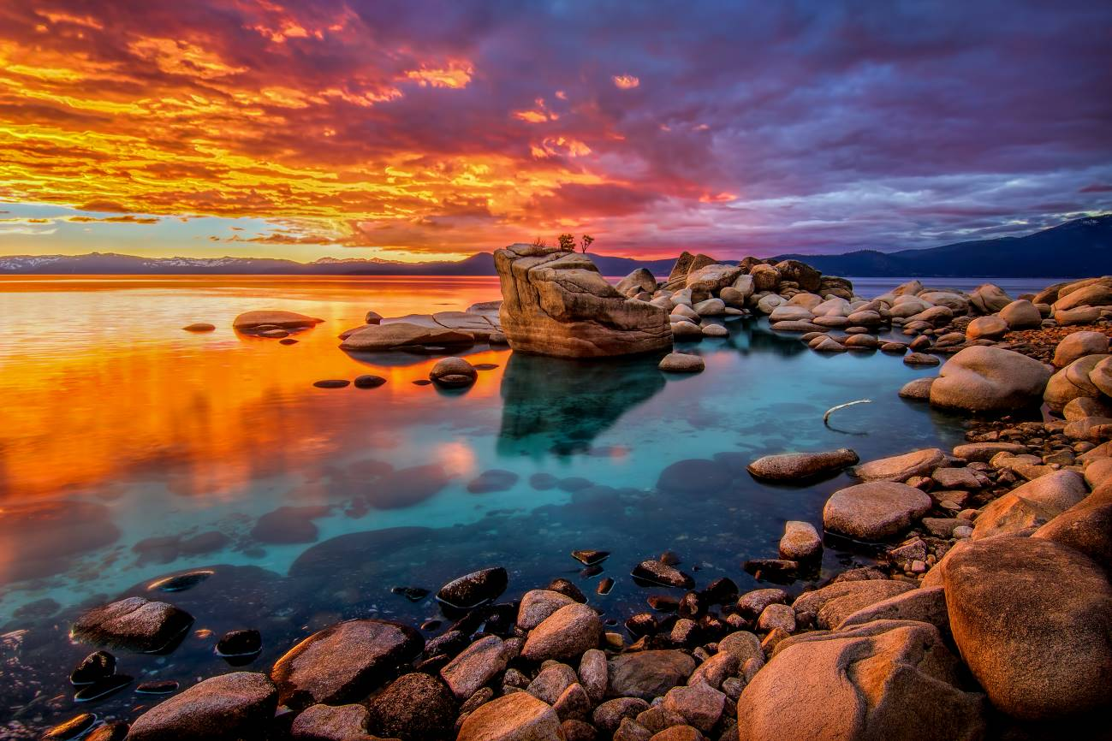
4 Advanced Types of Digitized Image High Dynamic Range (HDR) Image
** we can see an increased detail in the highlights and shadows of the picture taken in HDR
Image taken from viewsonic.com

Slide 7
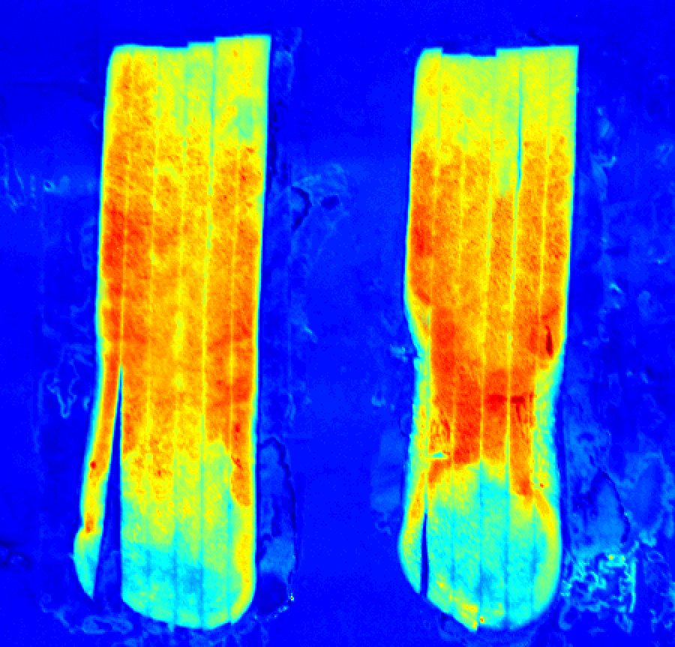
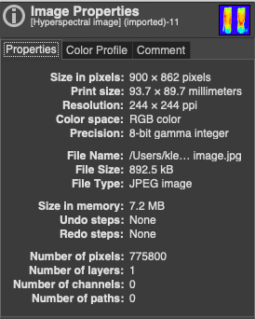
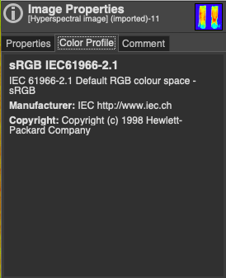
4 Advanced Types of Digitized Image Hyperspectral Image
This is what the image looks like but the original file cannot be read by GIMP because you need a programming software in order to read it
Image taken from Wikipedia

Slide 8
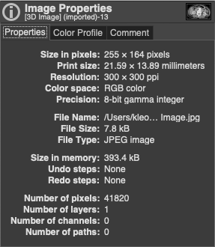
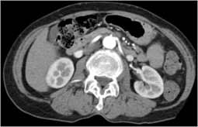
4 Advanced Types of Digitized Image 3D Image
Image taken from radiologyinfo.org

Slide 9
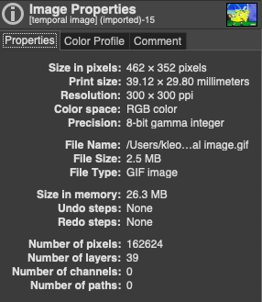

4 Advanced Types of Digitized Image Temporal Image
More layers because of compression of ‘multiple single images’!

Slide 10
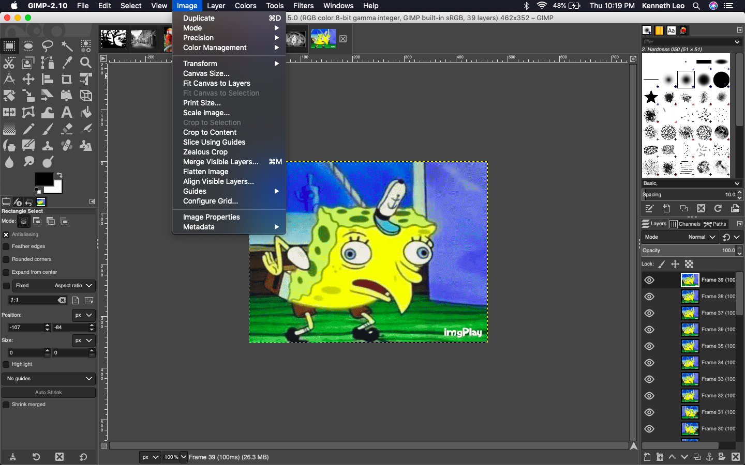
Where to find? Image Properties

Slide 11
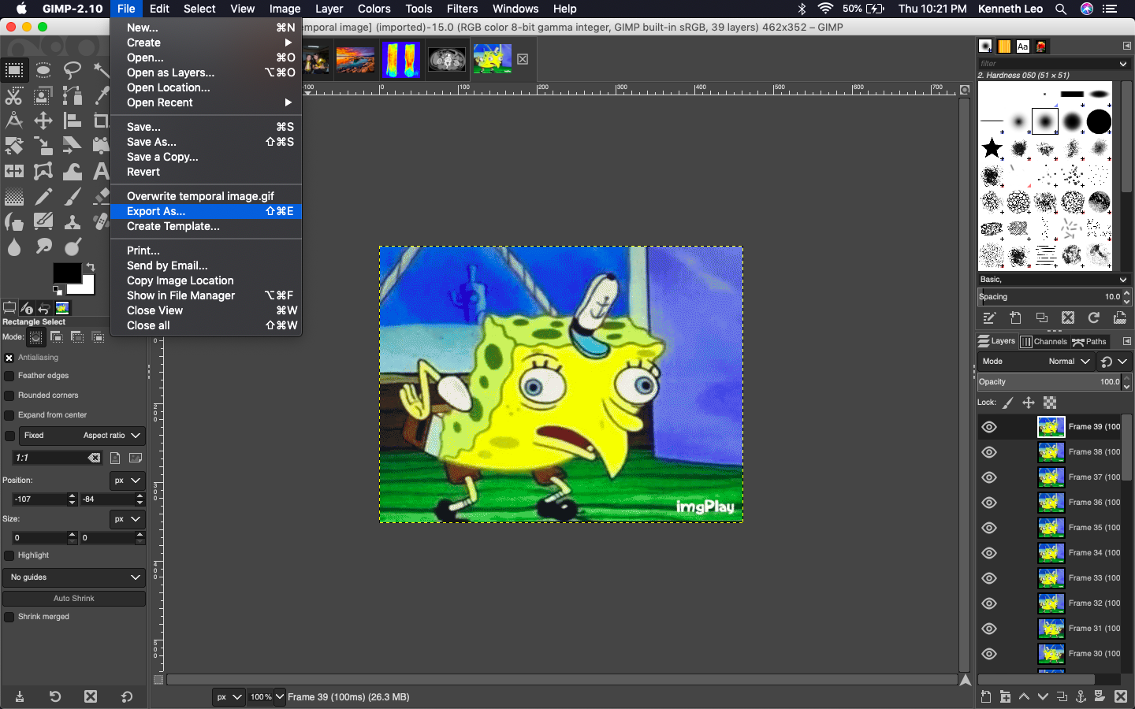
Where to find? Export/Make a Copy

Slide 12
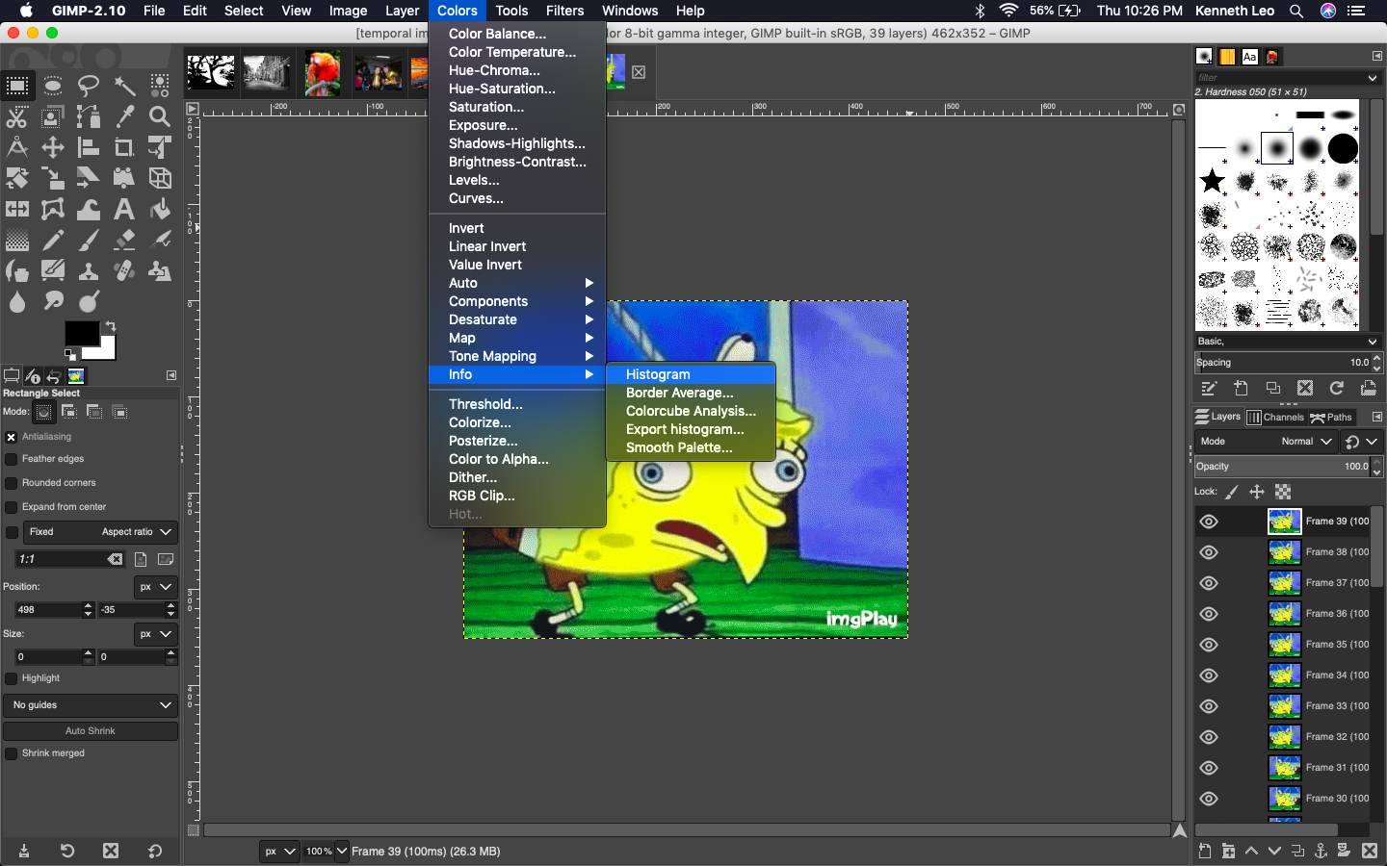
Where to find? Image Properties

Slide 13
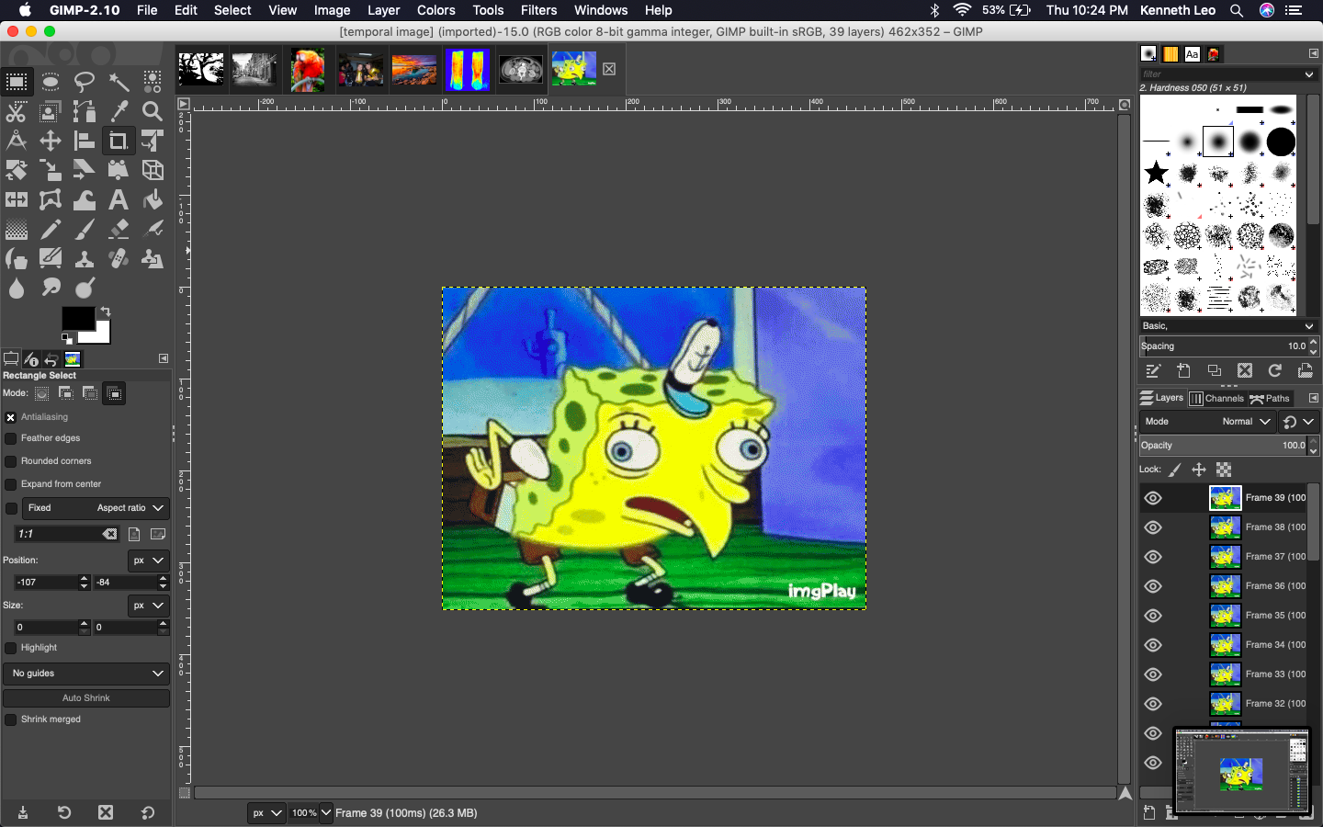
Where to find? Crop

Slide 14
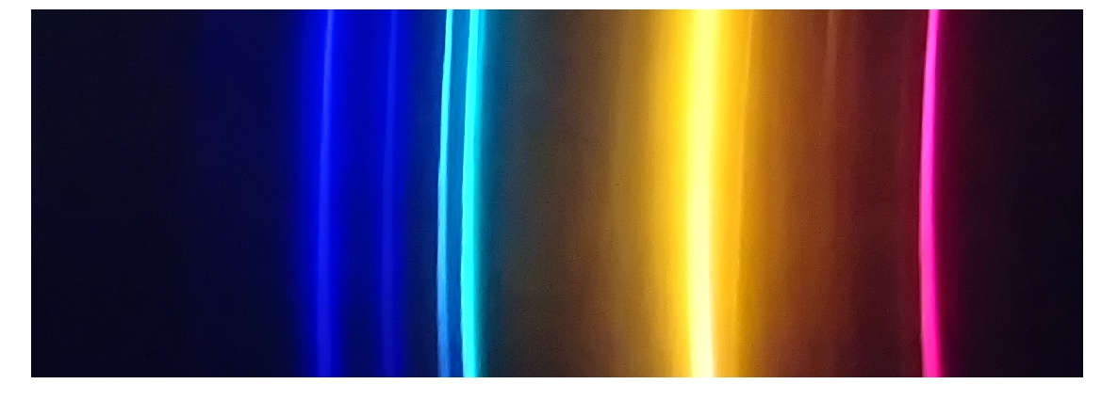

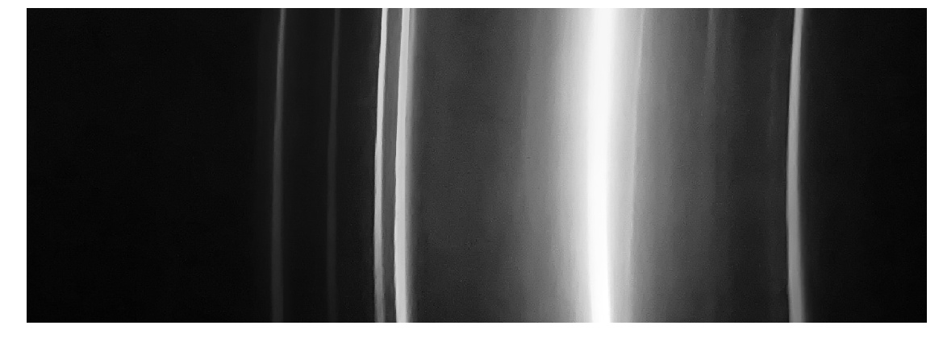
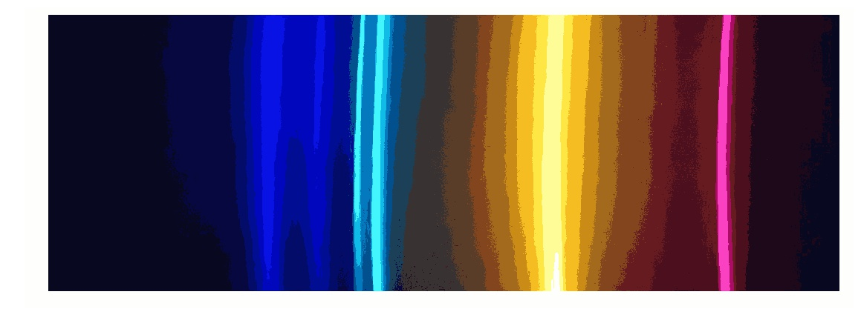
Truecolor Image
Binary Image
Grayscale Image
Indexed Image

Slide 15
We can see that the truecolor image has the highest file size. This is because it contains the most information out of the four. On the other hand, the binary image has the smallest file size due to the fact that the image is just a 2D array composed of 0s and 1s.
Truecolor image – has the most complete details
Binary image – composed of black and white color only, no other colors found
Grayscale image – A grayed version of the truecolor, not purely black and white
Indexed image – colors have been limited depending on the number of indices you used, the indices kind of represent the number of bins you divided the colormap into.
** I created the binary, grayscale, and indexed images in Python using Jupyter notebook. The code I wrote only requires the truecolor image as the input. My notebook file can be viewed and downloaded here: http://tiny.cc/Activity3AP186

Slide 16
Common Image File Formats Source: https://guides.lib.umich.edu/c.php?g=282942&p=1885348 and https://www.widen.com/blog/whats-the-difference-between-png-jpeg-gif-and-tiff
JPEG
Pros: Used for websites and e-mails because of its small file size.
Cons: Some information can be lost because of compression
Extension: .jpg, .jpeg
PNG
Pros: Compressed but without loss of quality. Transparent. Best used for logos, charts, and diagrams.
Cons: Cannot be used when sharing high-quality resolution photos on the web
Extension: .png

Slide 17
Common Image File Formats Source: https://guides.lib.umich.edu/c.php?g=282942&p=1885348 and https://www.widen.com/blog/whats-the-difference-between-png-jpeg-gif-and-tiff
TIFF/TIF
Pros: Used for professional publications, archival copies and high quality prints because no compression is made. This means that all information are saved.
Cons: Very large file sizes (not suitable to use for web images)
Extension: .tif, .tiff
BITMAP
Pros: No compression/ no information loss which means very high quality images. Can also be used for archival copies and high-res images.
Cons: Proprietary format (only for Windows)
Extension: .bmp

Slide 18
Common Image File Formats Source: https://guides.lib.umich.edu/c.php?g=282942&p=1885348 and https://www.widen.com/blog/whats-the-difference-between-png-jpeg-gif-and-tiff
GIF
Pros: Can allow transparency and can be animated. Very small in size and can be very portable
Cons: Not very detailed
Extension: .gif
RAW Image files
Pros: Holds many image information since they are unprocessed images straight from a camera/scanner.
Cons: Cannot be used immediately because it still needs to be processed on an editor (Adobe Photoshop for example)
Extension: .raw, .cr2, .nef, .orf, .sr2, etc.

Slide 19
Self-Evaluation
Technical Correctness – 5 / 5
I understood the concept and I was able to produce all the need outputs, I even included screenshots of properties and even the sources of my information
Quality of Presentation – 5 / 5
The way I presented my report was easy to understand and follow. I simply provided screenshots for the ‘Where to find?’ part because it is easier to visualize rather than explaining it through words.
Initiative – 2
I did not just copy paste all the information but somewhat provided necessary details that I find important. I even wrote the pros and cons of each common file types that I found. I even wrote a code that convert a truecolor image to binary, grayscale, and indexed images.

